Slide 1

Linux Learning Workshop
Instructor: Tedley Meralus
Date: 03.27.17

Slide 2
Networking in Linux
Practical Networking concepts in Linux

Slide 4
Networking and Troubleshooting commands
Ifconfig
Iwconfig
iwconfig command in Linux is use to configure a wireless network interface. You can see and set the basic Wi-Fi details like SSID channel and encryption. You can refer man page of iwconfig to know more.

Slide 5

Can you turn it off then on again?
To enable or disable specific Interface
Enable eth0
Ifup eth0
Disable eth0
Ifdown eth0

Slide 6
Promiscuous mode
Ifconfig eth0 - promisc
Network interface only received packets belongs to that particular NIC. If you put interface in promiscuous mode it will received all the packets. This is very useful to capture packets and analyze later. For this you may require superuser access.

Slide 7
Ping Pong and Traceroute
PING (Packet INternet Groper) command is the best way to test connectivity between two nodes. Whether it is Local Area Network (LAN) or Wide Area Network (WAN). Ping use ICMP (Internet Control Message Protocol) to communicate to other devices. You can ping host name of ip address using below command.
Ping 8.8.8.8
traceroute is a network troubleshooting utility which shows number of hops taken to reach destination also determine packets traveling path. Below we are tracing route to global DNS server IP Address and able to reach destination also shows path of that packet is traveling.

Slide 8
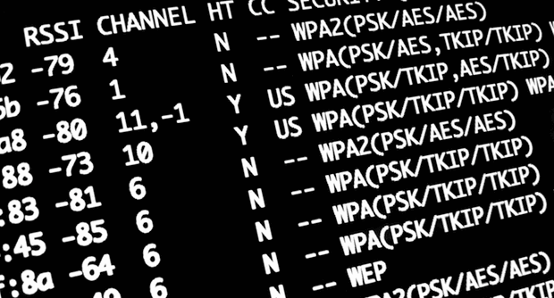
NETSTAT
NETSTAT Command
Netstat (Network Statistic) command display connection info, routing table information etc. To displays routing table information use option as -r.

Slide 9

NSLookup
NSLookup Command
nslookup command also use to find out DNS related query. The following examples shows A Record (IP Address) of tecmint.com.

Slide 10


Route
Route Command
route command also shows and manipulate ip routing table. To see default routing table in Linux, type the following command.

Slide 11


Adding and deleting routes
Route Adding
# route add -net 10.10.10.0/24 gw 192.168.0.1
Route Deleting
# route del -net 10.10.10.0/24 gw 192.168.0.1

Slide 12

Honeypots
Getting hacked? Use a honeypot

Slide 13
What is a Honeypot?
a honeypot is a computer security mechanism set to detect, deflect, or, in some manner, counteract attempts at unauthorized use of information systems.
This is similar to the police baiting a criminal, conducting undercover surveillance, and finally punishing the criminal.

Slide 14
Reasons to use
No not Winnie the Pooh, Honeypots

Slide 15
Low false positives, high success

Slide 16
Ability to Confuse Hackers

Slide 17
Only a time sink, if you allow it

Slide 18
Training for a Security Team

Slide 19
Just like Linux, There are free tools
http://www.darkreading.com/

Slide 20


Slide 21


Slide 22


What types of Honeypots are there?

Slide 23
Production honeypots are:
easy to use
capture only limited information
used primarily by companies or corporations.
Production honeypots are placed inside the production network with other production servers by an organization to improve their overall state of security.
low-interaction honeypots, which are easier to deploy.
They give less information about the attacks or attackers than research honeypots.

Slide 24
Research honeypots are:
to gather information about the motives and tactics of the Black hat community targeting different networks.
do not add direct value to a specific organization
used to research the threats that organizations face and to learn how to better protect against those threats.
complex to deploy and maintain
capture extensive information
are used primarily by research, military, or government organizations.

Slide 25
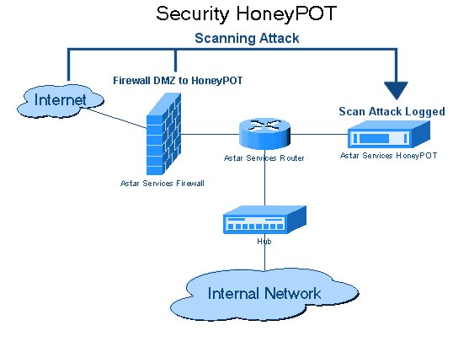

Slide 26

Hackers Get Honeypots
Use a honeypot
To monitor data breaches
Find out leaks of breaches
Patch up breaches

Slide 28
Lets use LAMP
Practical Networking concepts in Linux

Slide 29


What is LAMP?

Slide 30
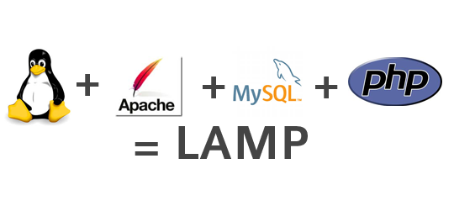
What is LAMP
LAMP is an open source Web development platform that uses Linux as the operating system, Apache as the Web server, MySQL as the relational database management system and PHP as the object-oriented scripting language. (Sometimes Perl or Python is used instead of PHP.)

Slide 31
Lets use a LAMP STACK
Practical Networking concepts in Linux

Slide 32
What is a LAMP stack
LAMP stack is a popular open source web platform commonly used to run dynamic web sites and servers. It includes Linux, Apache, MySQL, and PHP/Python/Perl and is considered by many the platform of choice for development and deployment of high performance web applications which require a solid and reliable foundation.

Slide 33

Network Software
Cacti is an open source web based network monitoring tool front-end for the data logging tool called RRDtool.
It’s allow users to check the services at an interval of time and resulting in the graph format. For more information about Cacti refer the official website.

Slide 34

Now that we have a web server lets move it to the cloud

Slide 35

What is the Cloud
the practice of using a network of remote servers hosted on the Internet to store, manage, and process data, rather than a local server or a personal computer.

Slide 36


Slide 37
Examples of Cloud Computing
Practical Networking concepts in Linux

Slide 38


Slide 39

Connect with the Instructor
Name: Tedley Meralus
email:tmeralus@gmail.com
Url: www.tedleymeralus.com
Twitter: @TechGameTeddy
Github: www.github.com/TechGameTeddy
Instagram: @TechGameTeddy
LInkedin name: https://www.linkedin.com/in/tmeralus

